Slide 1

RTOS Concepts
Synchronization Primitives
http://www.chibios.org

Slide 2
Synchronization
In a multi-threaded system the most common problem is to make the various thread synchronize and/or exchange data
Often synchronization and communication are the same thing
There is not a single “best way” to perform communication or synchronization, it depends on requirements
An RTOS should offer a rich set of synchronization and communication primitives in order to let the designed select the best tool for the task at hand
Examples of Synchronization primitives (taken from ChibiOS/RT):
  Critical Zones
  Counting Semaphores and Binary Semaphores
  Mutexes and Condition Variables (Monitors)
  Event Flags and Event Sources
  Synchronous Messages
  Mailboxes

Slide 3
Critical Zones
A Critical Zone is a very simple construct, from within critical zones Contex Switch cannot happen. This is usually done by disabling the interrupts.
Critical Zones are a lightweight mechanism for Mutual Exclusion
Critical Zones have the advantage to be able to implement Mutual Exclusion between ISRs, between Threads and also between ISRs and Threads
Use of Critical Zones can degrade the system performance by increasing the overall Jitter, it is advisable to use them only for very short code paths
ISR1_prio10() {
…
lock()
// Access shared resource
resource = resource + 1
unlock()
…
}
ISR2_prio20() {
…
lock()
// Access shared resource
resource = resource + 1
unlock()
…
}
Thread1() {
…
lock()
// Access shared resource
resource = resource - 1
unlock()
…
}
A Critical Zone implements a very special case of Priority Ceiling algorithm by raising the priority temporarily to the absolute maximum level. This mean that their use is not affected by Priority Inversion.

Slide 4
Semaphores
Semaphores are a common construct sharing several characteristics:
Semaphores do not have an “owner”, a Semaphore can be locked by one Thread and unlocked by another Thread or even an Interrupt Handler
Semaphores can be in two states (or two classes of states): locked or not locked
Semaphores can be initialized in their locked or not locked states
There are several possible implementation of Semaphores but all share the above characteristics, for example:
Counting Semaphores
Binary Semaphores
Semaphores can be useful in many ways:
Mutual Exclusion
Synchronization between ISRs and Threads
Resources Guards

Slide 5

Counting Semaphores
Counting Semaphores are a well known construct defined by Edsger Dijkstra in 1965 and commonly implemented in may operating systems. This kind of semaphores have an internal signed integer counter which defines the internal state.
If (counter <= 0) then the semaphore is locked
If (counter > 0) then the semaphore is unlocked
Three operations are defined for Counting Semaphores:
init(sem,n) Initializes the semaphore to the value ‘n’ which must be non-negative
wait(sem) Decrease the counter, if the value becomes negative the caller is suspended
signal(sem) Increase the counter, if the value becomes non positive one thread is resumed
The inner working can be described using a state machine:

Slide 6
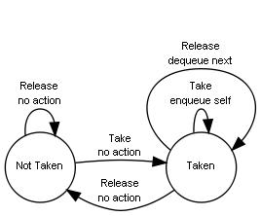
Binary Semaphores
Binary Semaphores are a semaphore variant where the internal state is described by a boolean value.
If (flag = 0) then the semaphore is locked (taken state)
If (flag <> 0) then the semaphore is unlocked (not taken state)
Three operations are defined for BinarySemaphores:
init(sem,b) Initializes the semaphore to the boolean value ‘b’
wait(sem) If the flag is zero the caller is queued else the flag is set to FALSE
signal(sem) If there is a thread in queue then it is resumed else the flag is set to TRUE
Even in this case the inner working can be
described using a state machine:

Slide 7
Semaphores Example
The most obvious use example for a semaphore is mutual exclusion, both binary and counting semaphores can be used, we assume that the semaphore has been initialized to ONE if counting or TRUE if binary, everything else is the same:
Thread1 {
forever {
…
wait(sem)
// Access shared resource.
resource = resource + 1
signal(sem)
…
}
}
Thread2 {
forever {
…
wait(sem)
// Access shared resource.
resource = resource - 1
signal(sem)
…
}
}
Note that Semaphores do not have an owner thread so the Priority Inversion problem cannot be addressed using them for Mutual Exclusion.

Slide 8
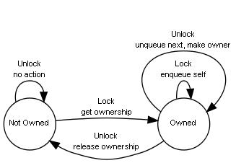
Mutexes
Mutexes are often mistaken with Binary Semaphores but there are important differences:
Mutexes can be in two states: owned or not owned
Mutexes can only be initialized in their not owned state
Mutexes can implement algorithms like Priority Ceiling or Priority Inheritance
Mutexes have an “owner”, the thread owning a mutex is the only one able to release it
Three operations are defined for Counting Semaphores:
init(mtx) Initializes the mutex
lock(mtx) Gains ownership of the mutex, waiting if the mutex is already taken
unlock(mtx) Releases a mutex, a waiting thread, if any, is resumed and made owner

Slide 9
Event Sources
A common need is to make a thread wait for one or multiple events, a common mechanism are Event Sources. This mechanism allows a thread to register itself as interested in events generated by one or more sources.
Three operations are defined for Event Sources:
register(source, id) Registers the thread on “source” assigning it the identifier “id”
id = wait() Suspends the thread until one of the sources becomes signaled
broadcast(source) All the threads interested in “source” are signaled
This mechanism is best used when we want to adopt an event-driven programming paradigm. In this scenario there is one thread serving events generated by multiple sources.
One other advantage is that events can be broadcasted by both threads or ISRs.

Slide 10
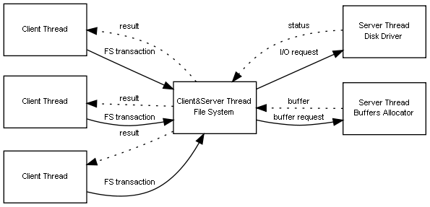
Messages and Mailboxes
Client/Server Approach
In order to avoid the use of mutual exclusion zones a possible approach to multi-threading is to organize the system as a set of communicating entities. Threads can act as both servers and clients. Each thread is the server of the resources it is handling but can also as a client and request services from other threads.
Under this kind of organization there is no need of Mutual exclusion, each shared resources is guarded by a thread that also coordinates the accesses to the resource.
This approach effectively implements a Priority Ceiling approach.
There are two kind of messages implementations, synchronous messages or asynchronous messages (Mailboxes). When a synchronous message is sent the sender is blocked until a response is returned. An asynchronous message requires no answer, mailboxes are mono directional in nature.

Slide 11

End

